Slide 1
CYBERSECURITY - PROJECT REVIEW
TITLE:-
Simple Data Leak Detection
reg-no:-
20BRS1207
Mudunoori Rohan Raj

Slide 2
Abstract:
The project aims to develop a lightweight data leak detection tool for cybersecurity purposes, designed to identify sensitive information, such as social security numbers, credit card numbers, and email addresses, within text files. Unlike traditional solutions, this tool operates without the need for external libraries, ensuring simplicity and portability. The methodology involves defining specific patterns for sensitive data, reading files, employing regular expressions for pattern matching, and generating a concise report detailing identified leaks.

Slide 3
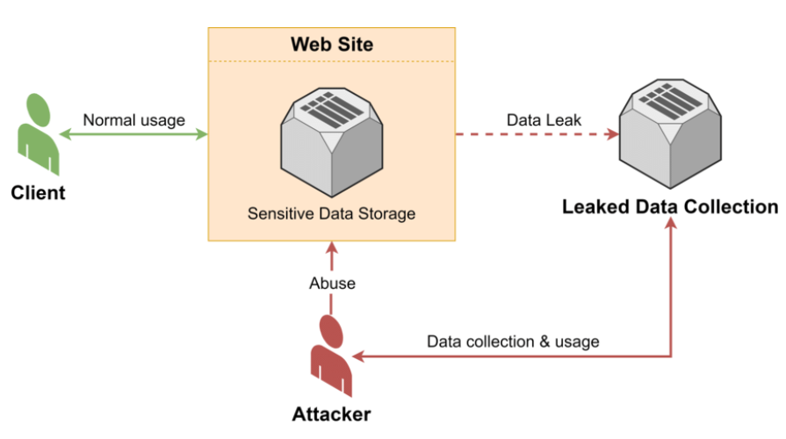
Data leakage flow diagram

Slide 4
Explanation:
Objective:
The primary objective is to create a minimalistic yet effective data leak detection tool that can be employed without the necessity of external libraries. The focus is on simplicity, making the tool accessible and easy to deploy.
Sensitive Data Patterns:
The project identifies three types of sensitive information: social security numbers, credit card numbers, and email addresses. Regular expressions are utilized to define the patterns for each category, enabling accurate detection within text files.
Read File Function:
The read_file function is responsible for reading the contents of a specified file. This function ensures that the tool can handle different file types and sizes, maintaining flexibility in its application.

Slide 5
Search for Sensitive Data:
The search_for_sensitive_data function utilizes regular expressions to locate instances of sensitive data within the text obtained from the file. The identified data is categorized into social security numbers, credit card numbers, and email addresses for a systematic analysis.
Report Generation:
The generate_report function constructs a detailed report summarizing the results of the data leak detection. The report includes the categories of sensitive data found and the specific instances detected. This facilitates a clear understanding of potential security risks.
Main Function:
The main function orchestrates the entire process by incorporating the file reading, data search, and report generation functions. The tool is designed to be executed from the command line, with the file path as a configurable parameter.

Slide 6
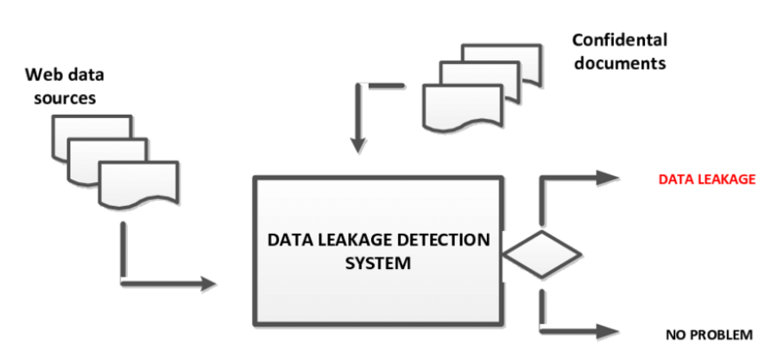
Data leakage detection system.

Slide 7
Conclusion:
This project provides a foundational framework for a data leak detection tool, prioritizing simplicity and independence from external dependencies. While the example is rudimentary, it serves as a starting point for further development and customization based on specific cybersecurity needs. It is crucial to conduct extensive testing, consider error handling, and adhere to cybersecurity best practices before deploying such a tool in a production environment. The project encourages exploration and expansion, fostering the development of more robust and tailored solutions in the realm of cybersecurity.

